Slide 1
TOY STORE KPI REPORT
USING POWER BI

Slide 2
A brief summary of the project. (Screen shots below)
1. Connected to the data set
2. Uploaded the necessary tables (connecting to the source)
3. Checking the data quality of the table (Null values, missing fields, counts, distribution, data types, primary and foreign keys)
4. Identified date and price data types were wrong and corrected the same
5. Analyzed Max and Min Values, Count of stores from the primary key,
6. Column profiling selected to include the entire data set instead of first 100 columns
7. Adding column Start of the month
8. Checked data model and established "one to many " relationship as per the "STAR SCHEMA"
9. Created a date hierarchy
10. Hiding columns from the table in data model view
11. New column created, used “related” function to bring in columns from the “ones” table to the “many table” through the relationships set earlier
12. Creating new columns with formulas and updating the decimal places
13. Creating a new measure for total orders
14. Using the SUMX function to calculate revenue as a measure
15. Using format tool
16. Distributing the tables horizontally using the format option
17. Using the drill option to drill through the date hierarchy
18. Using the line smoothing option
19. Final finishing of the dashboard display (background, borders, spacing, edge rounding, padding, alignment etc.)

Slide 3
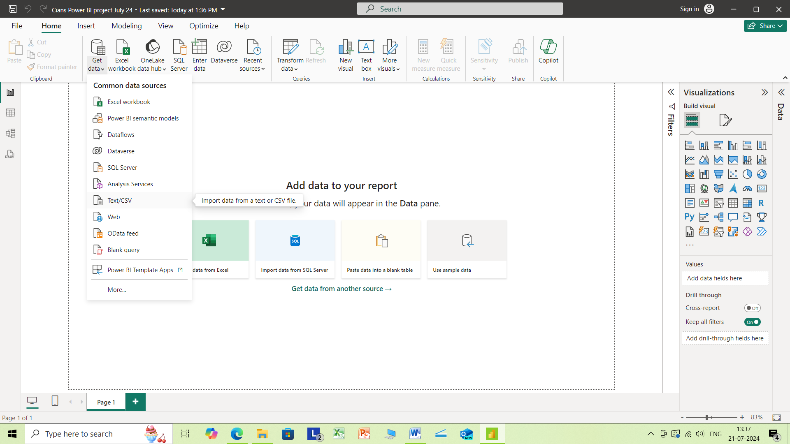

Slide 4
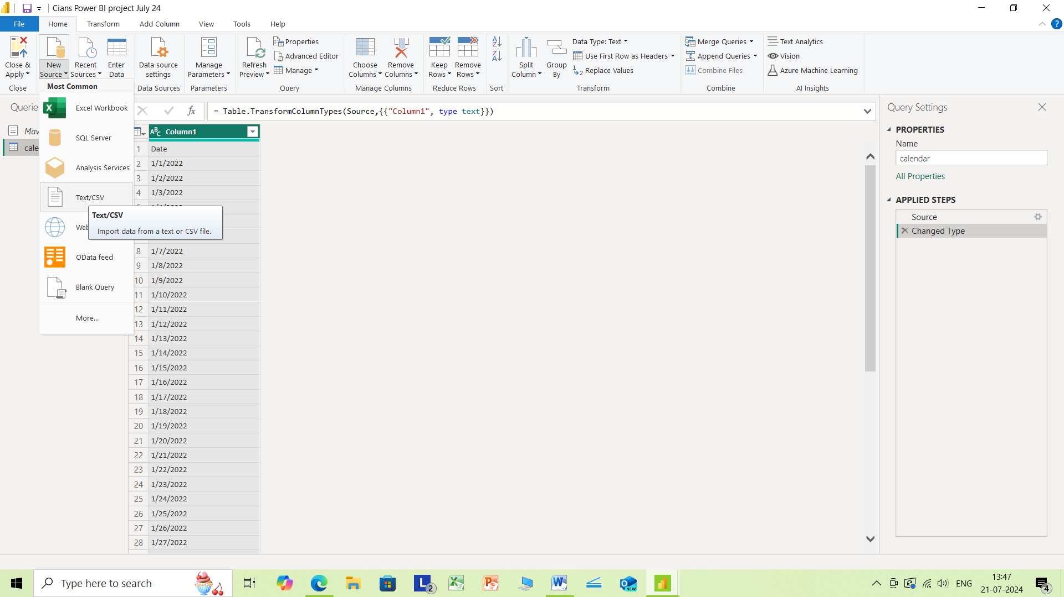

Slide 5
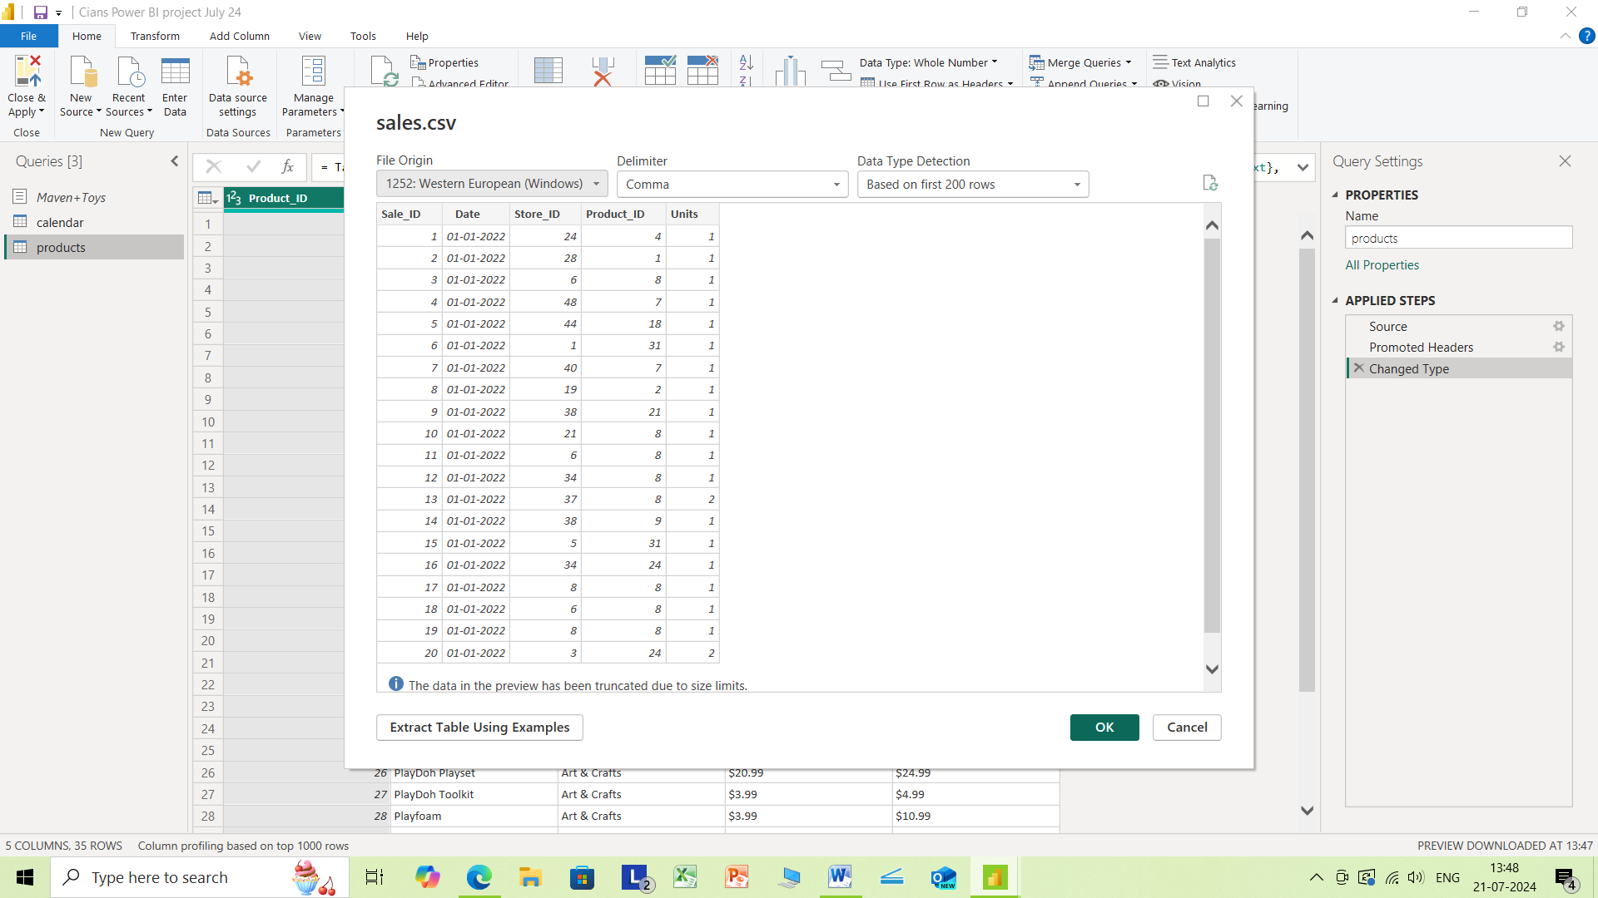

Slide 6
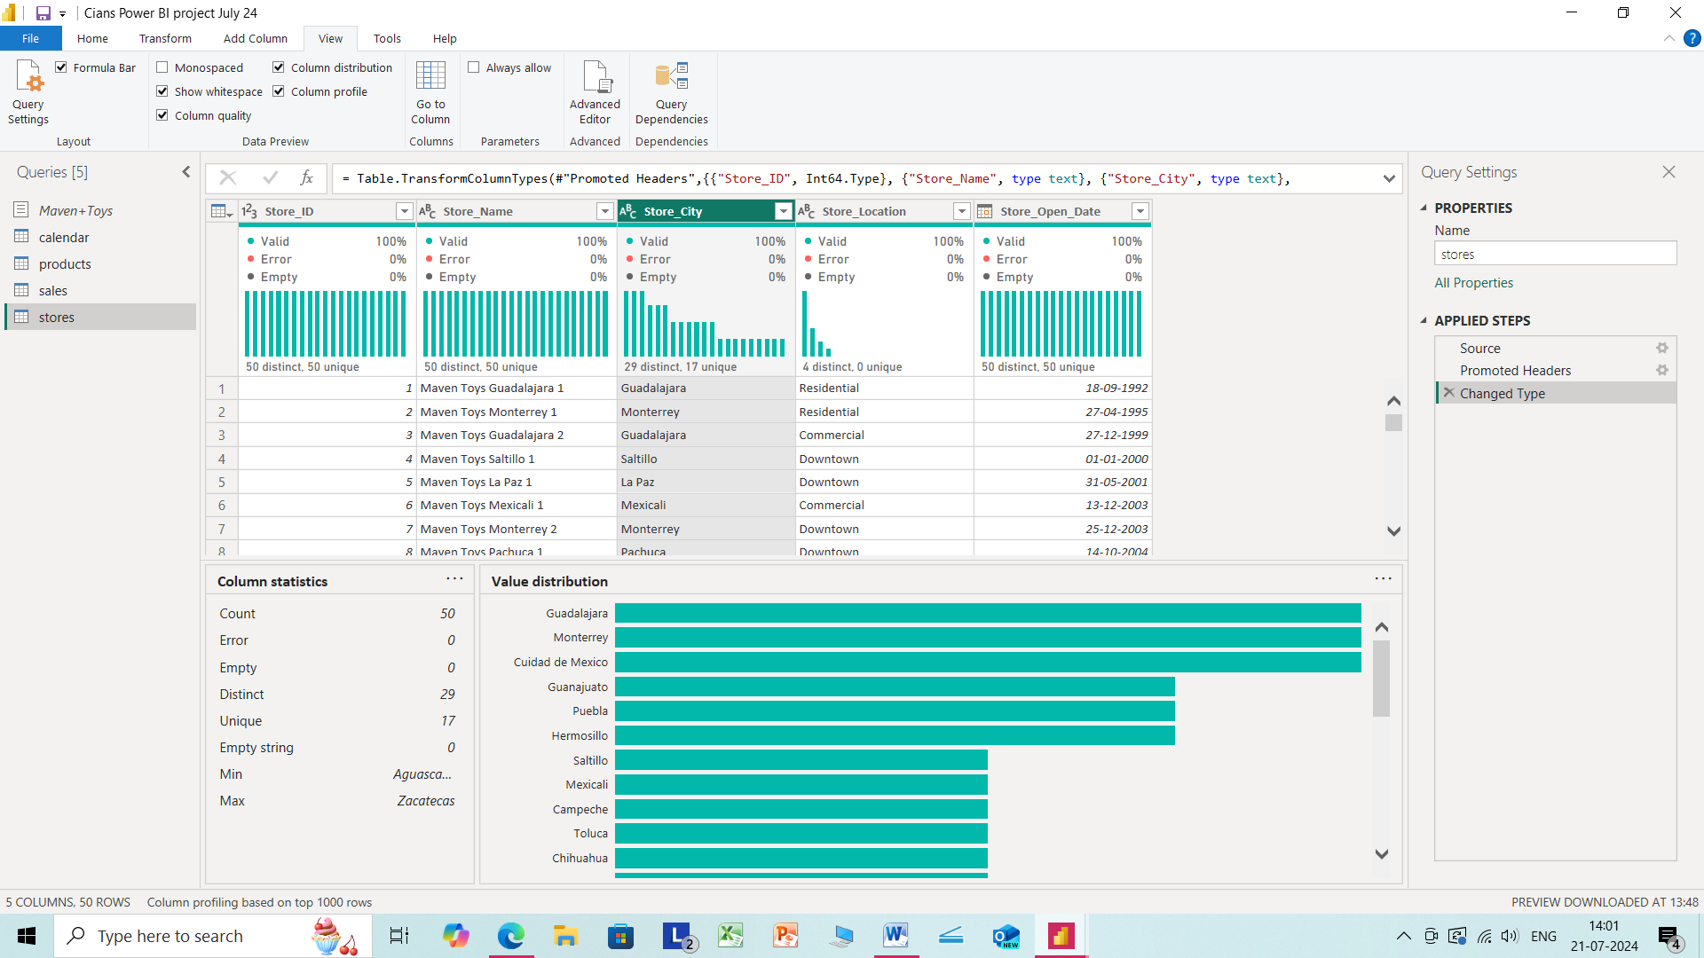

Slide 7
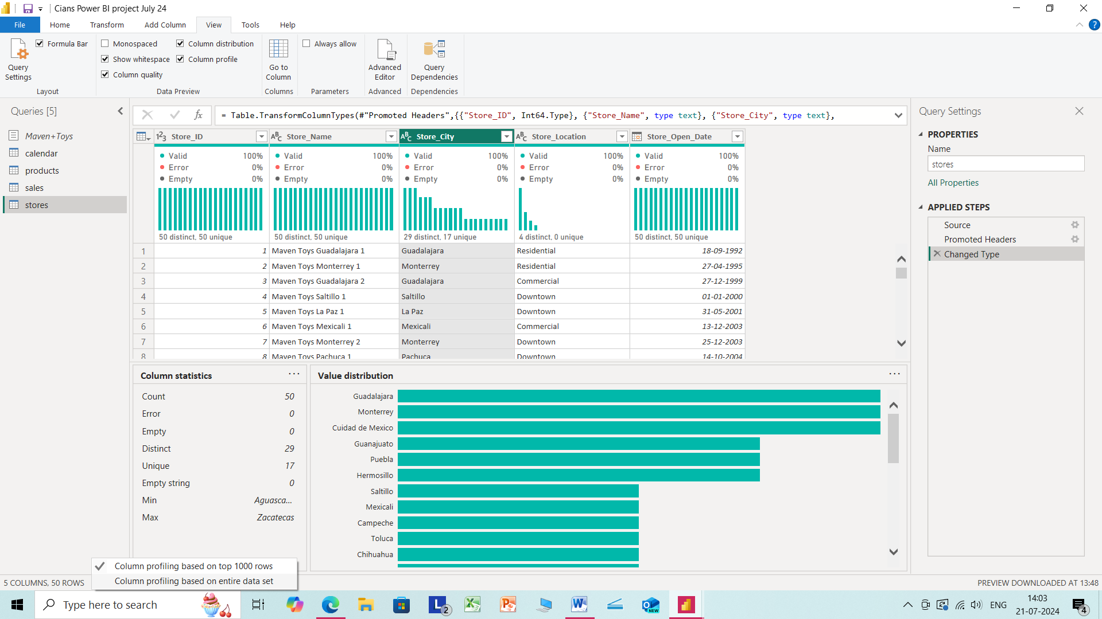

Slide 8
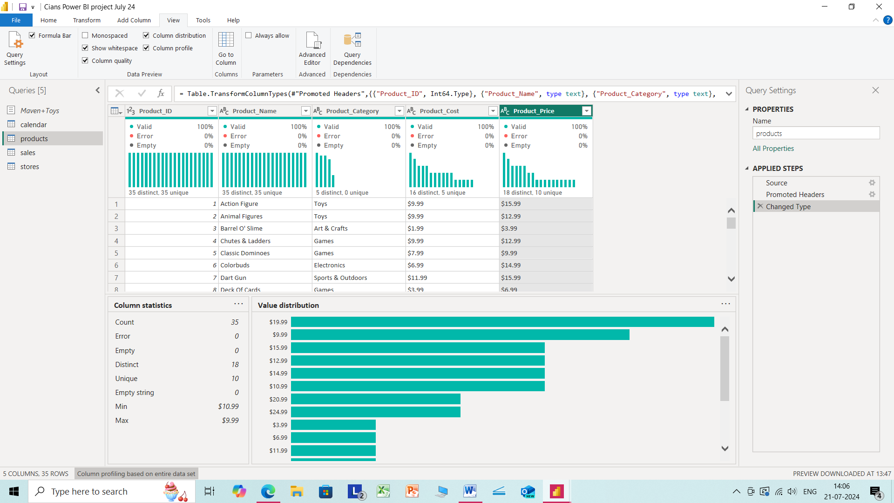

Slide 9
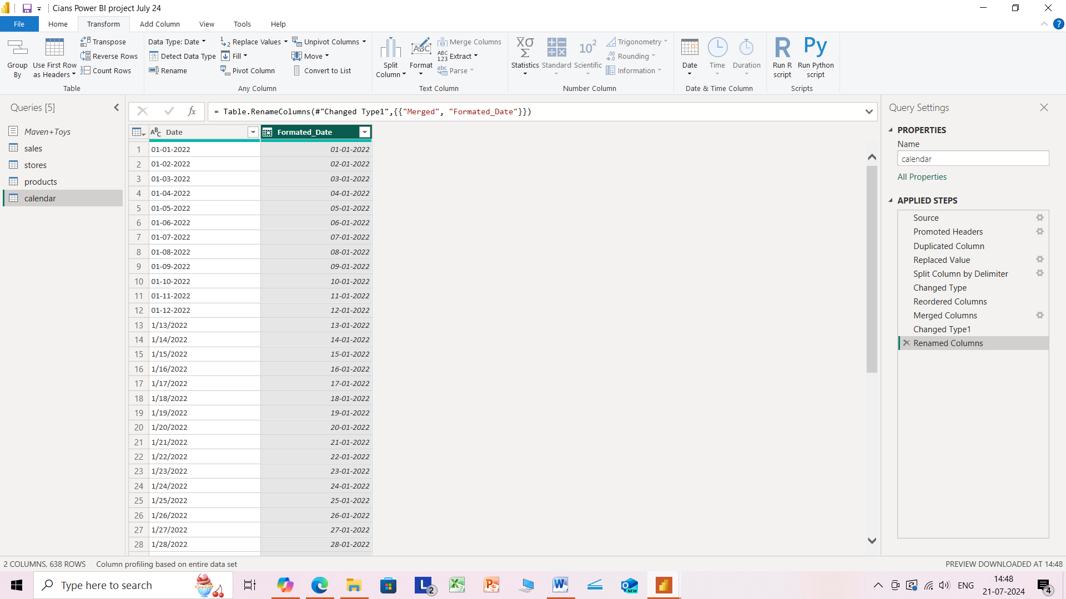

Slide 10
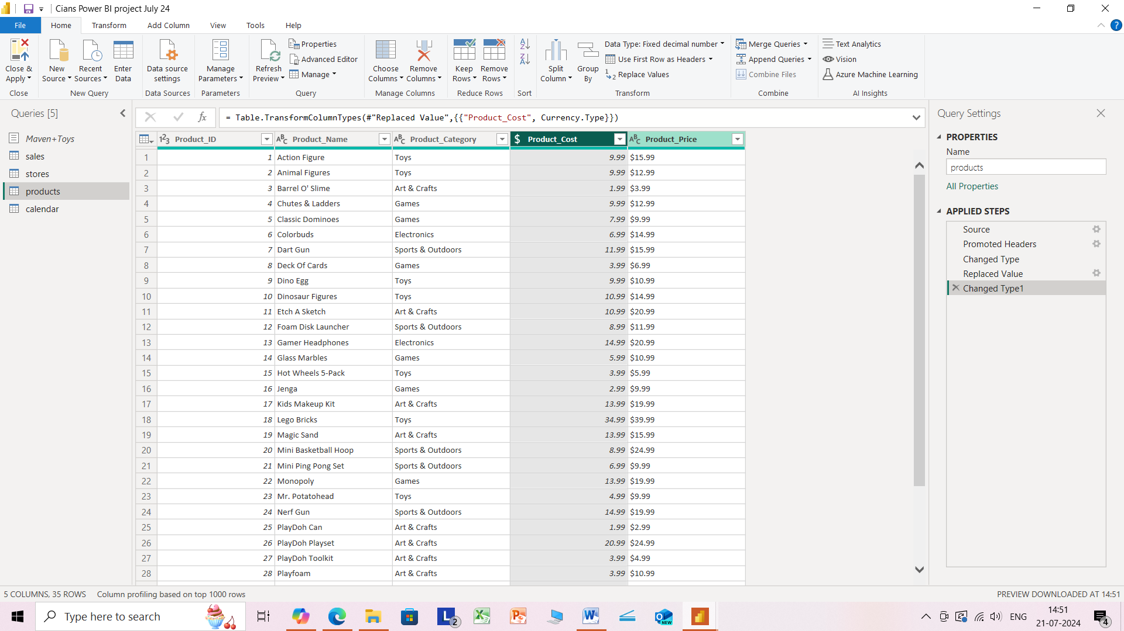

Slide 11
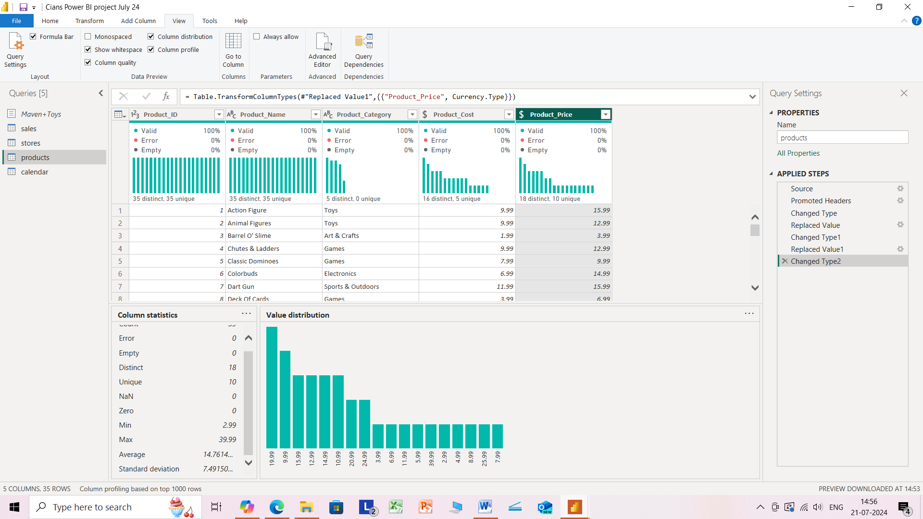

Slide 12
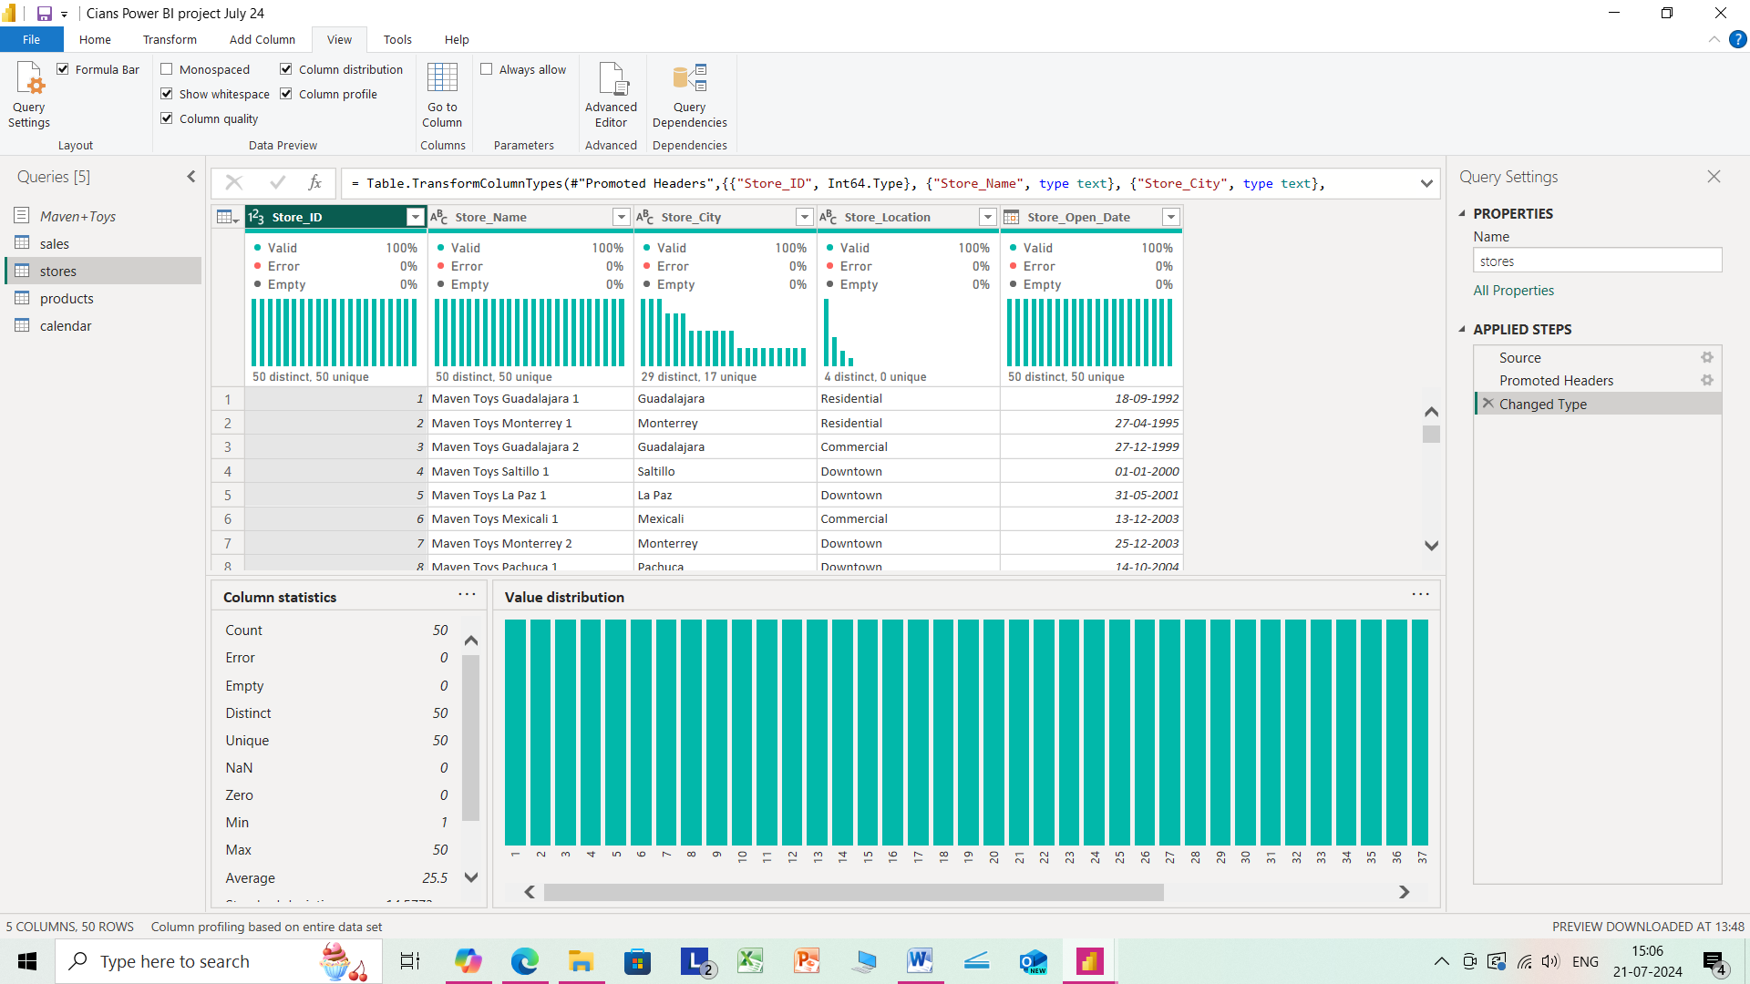

Slide 13
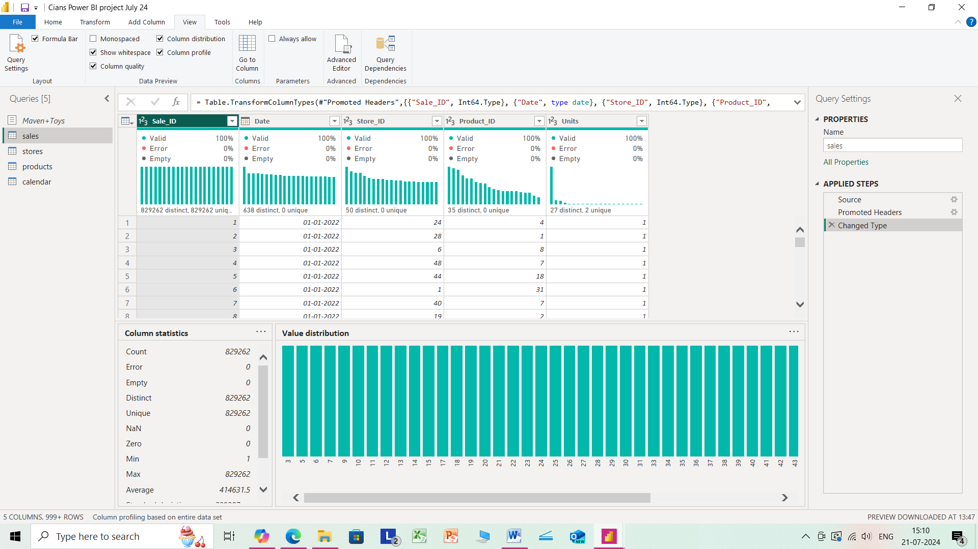

Slide 14
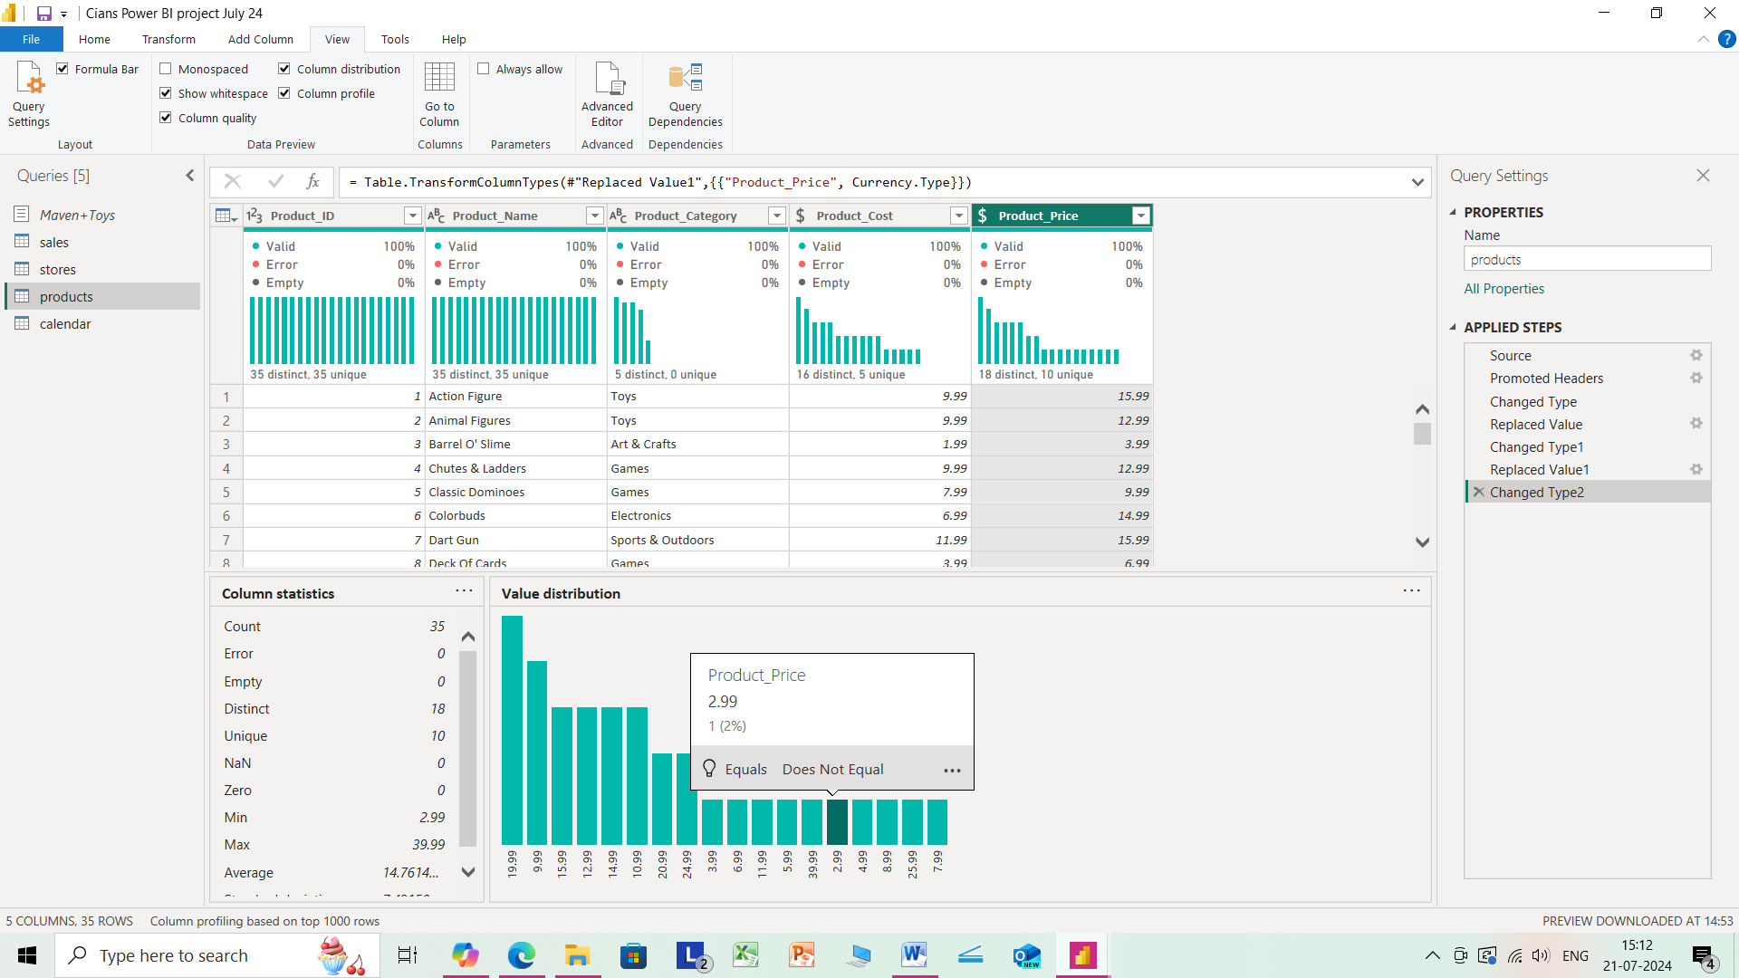

Slide 15
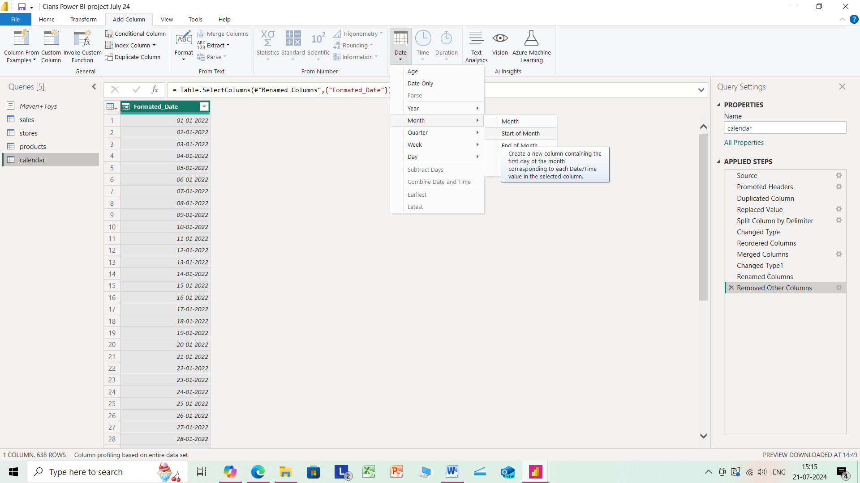

Slide 16
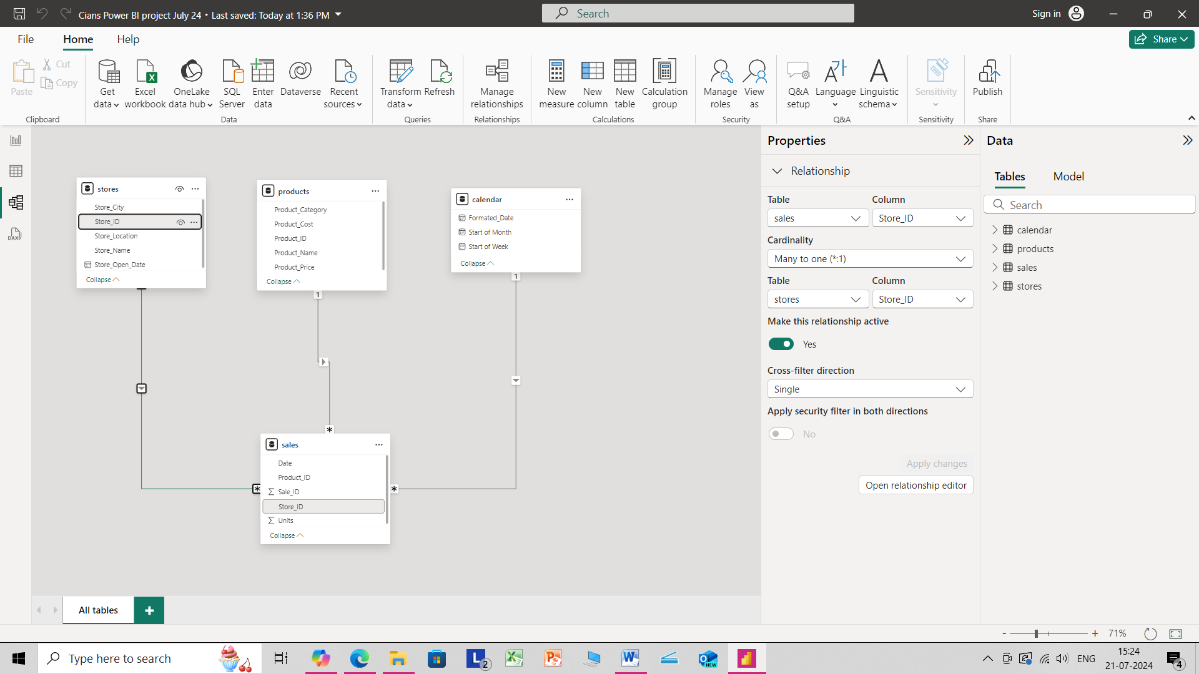

Slide 17
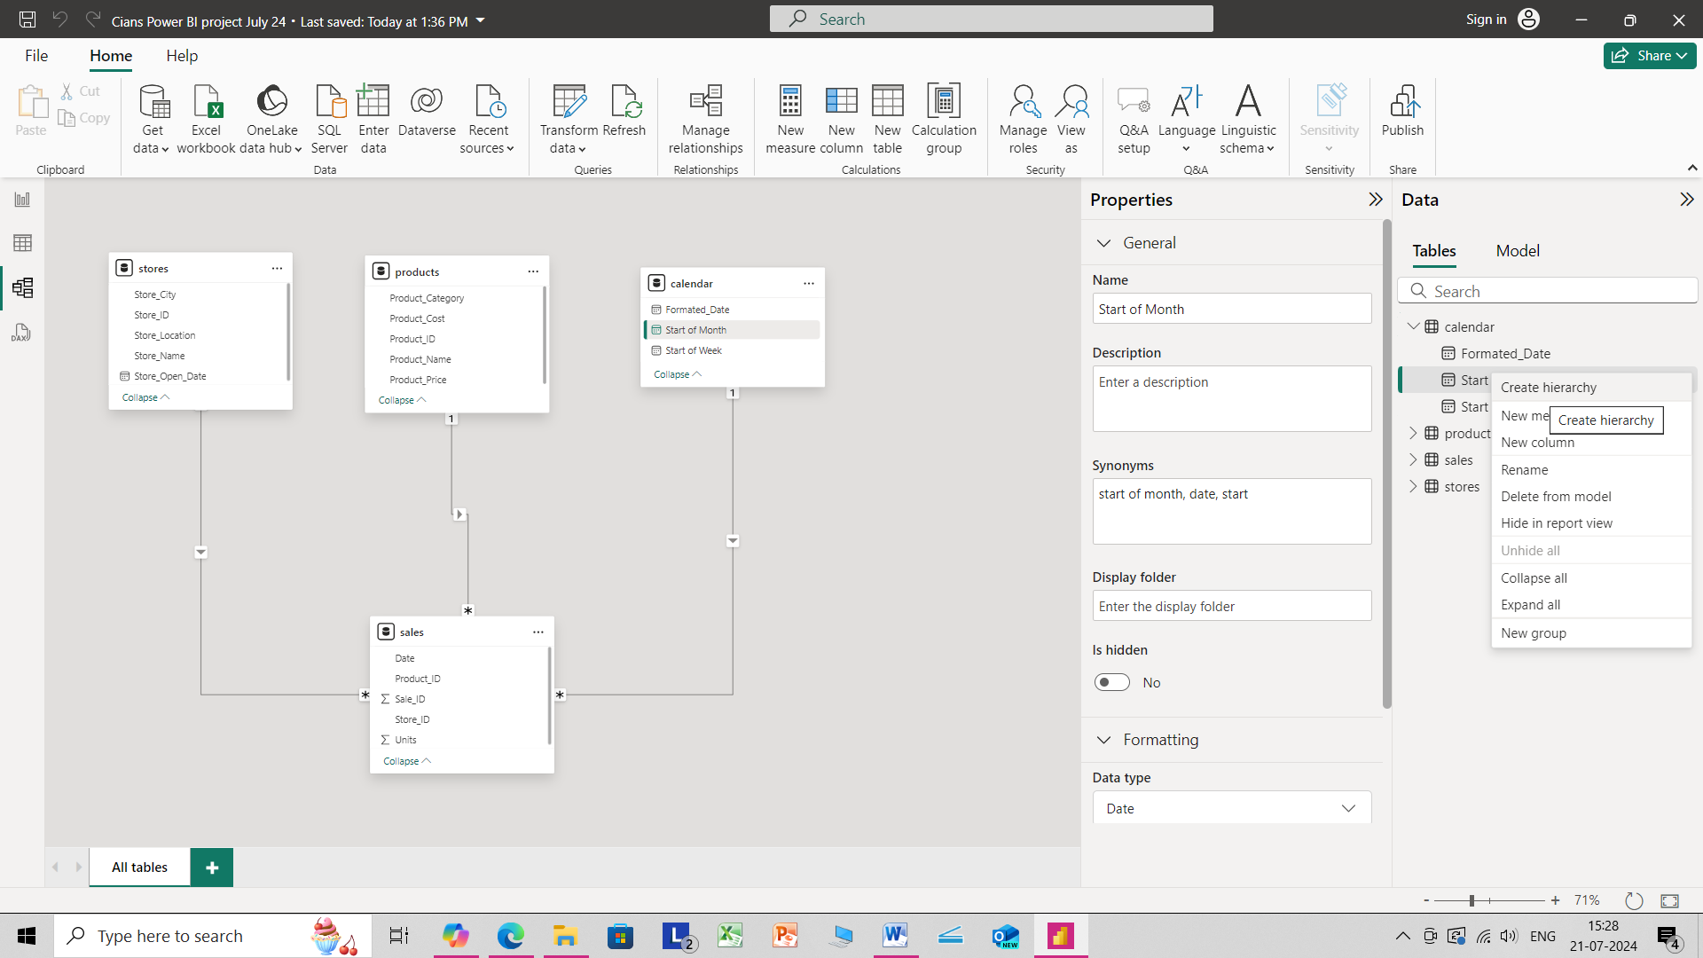

Slide 18
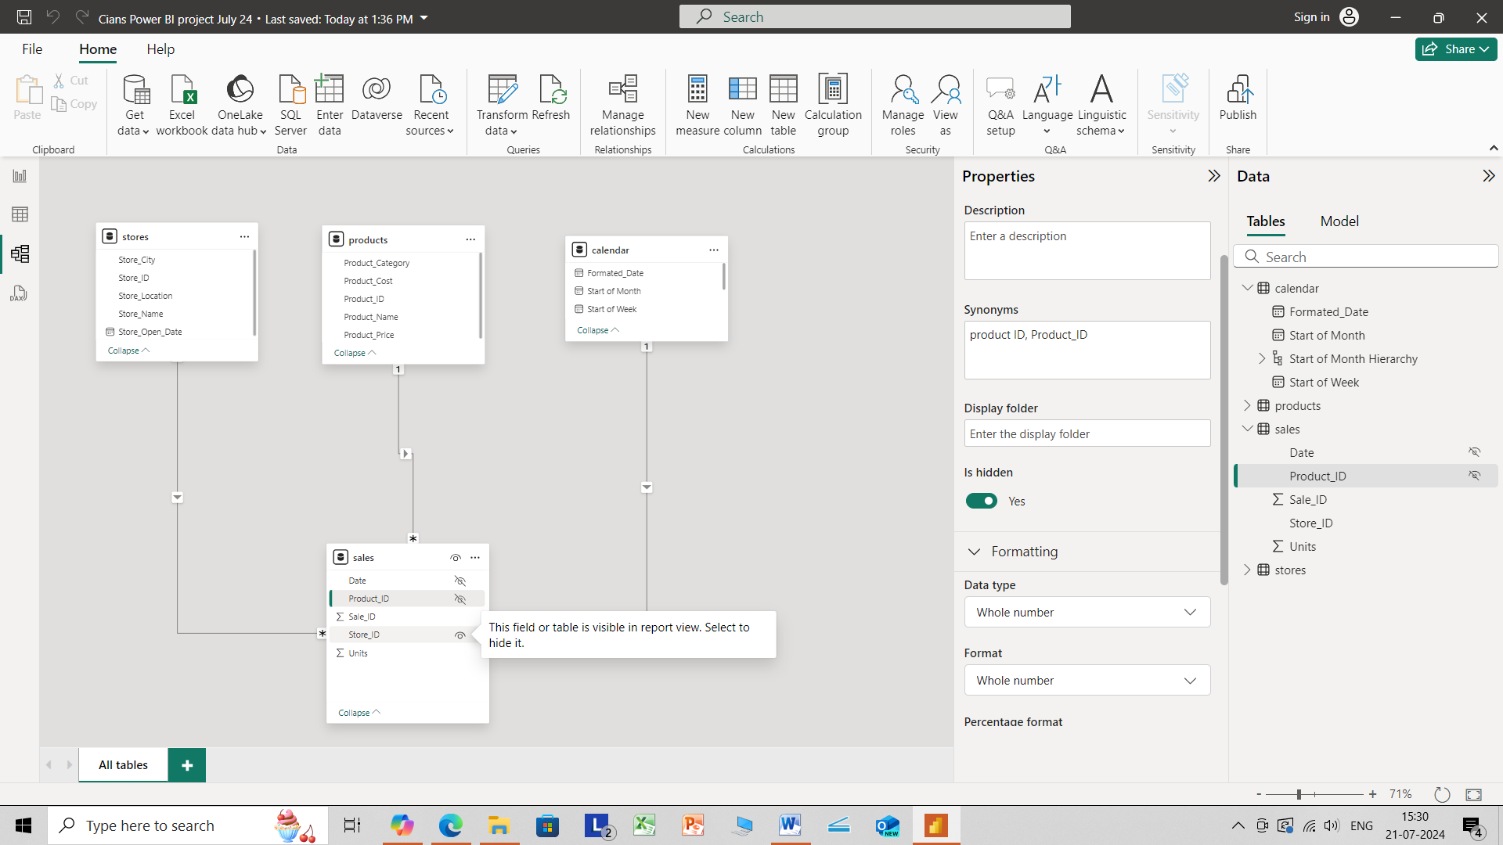

Slide 19
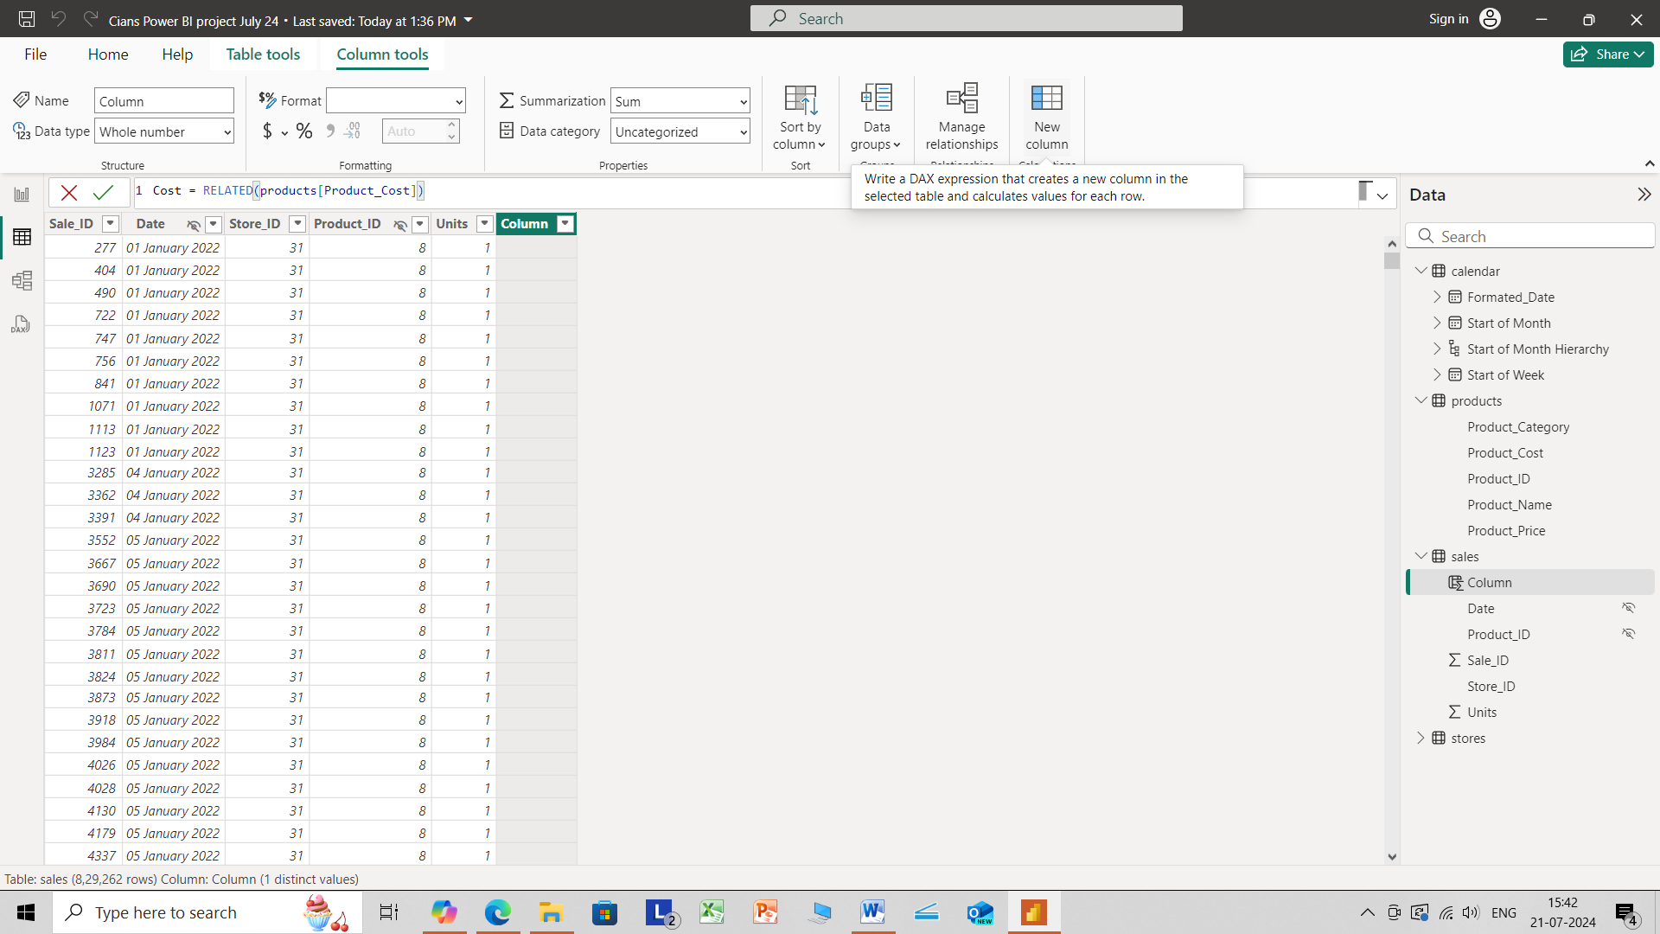

Slide 20
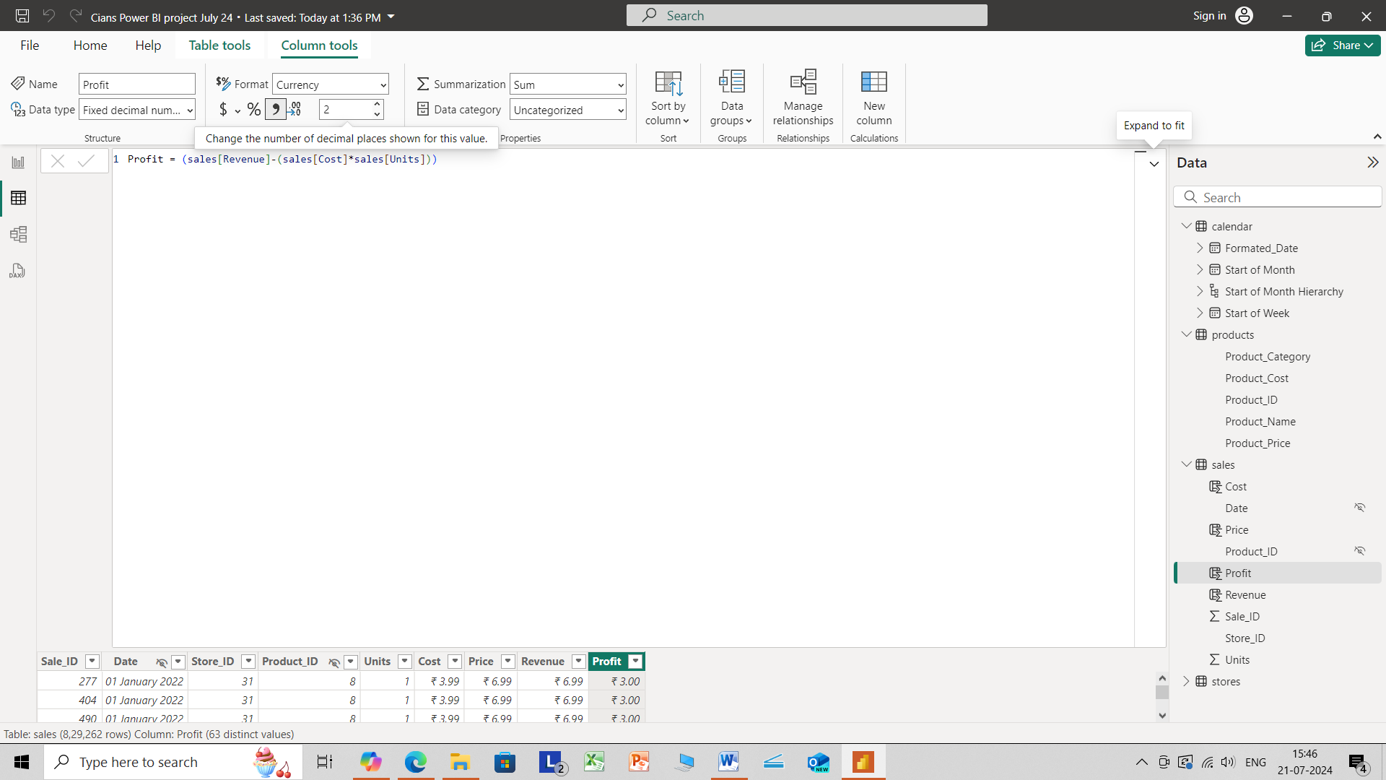

Slide 21
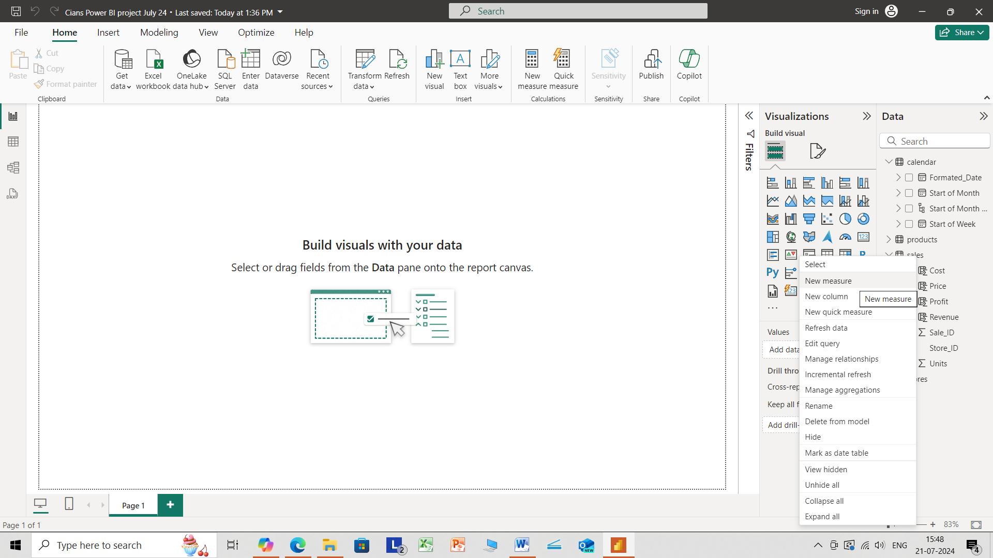

Slide 22
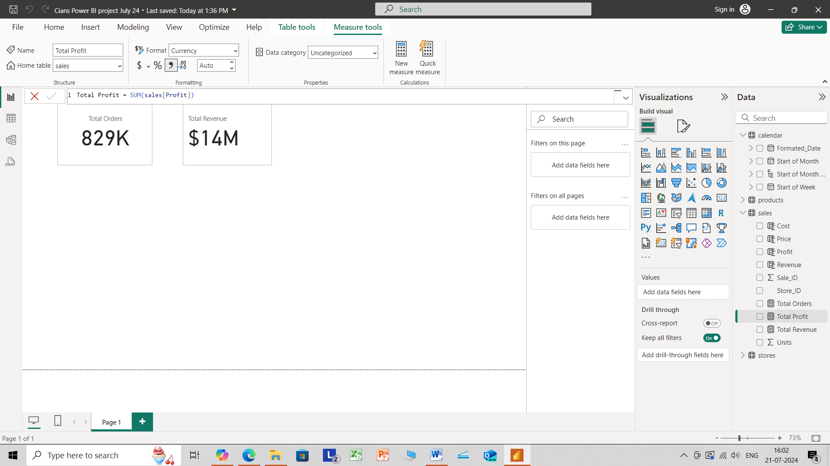

Slide 23


Slide 24
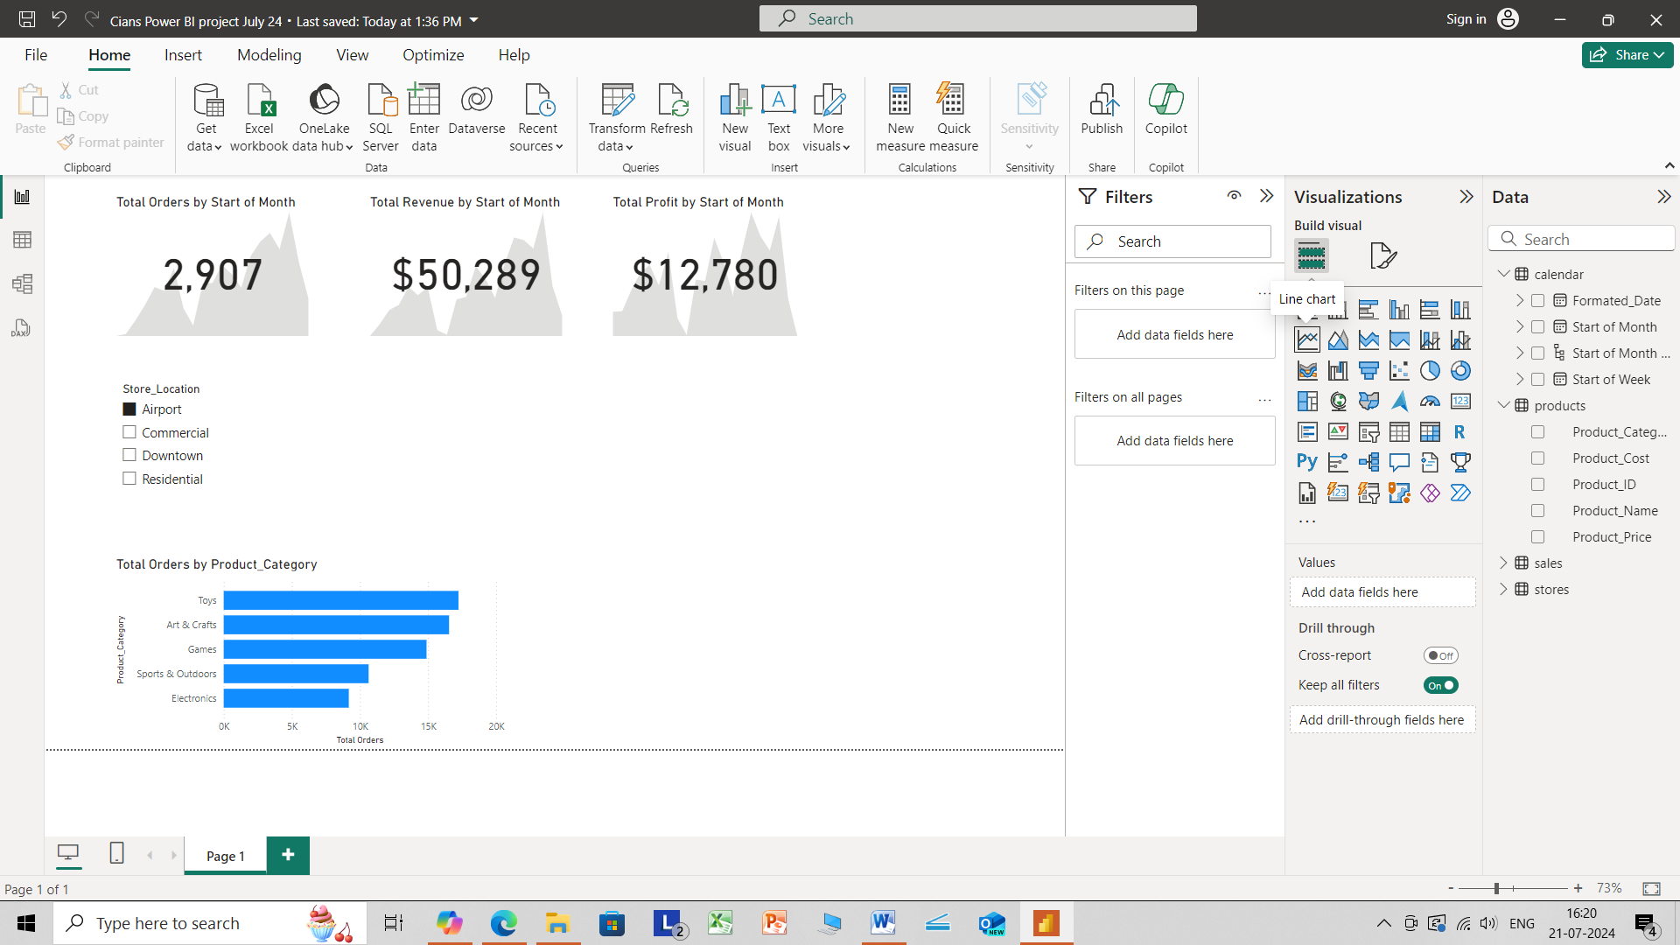

Slide 25
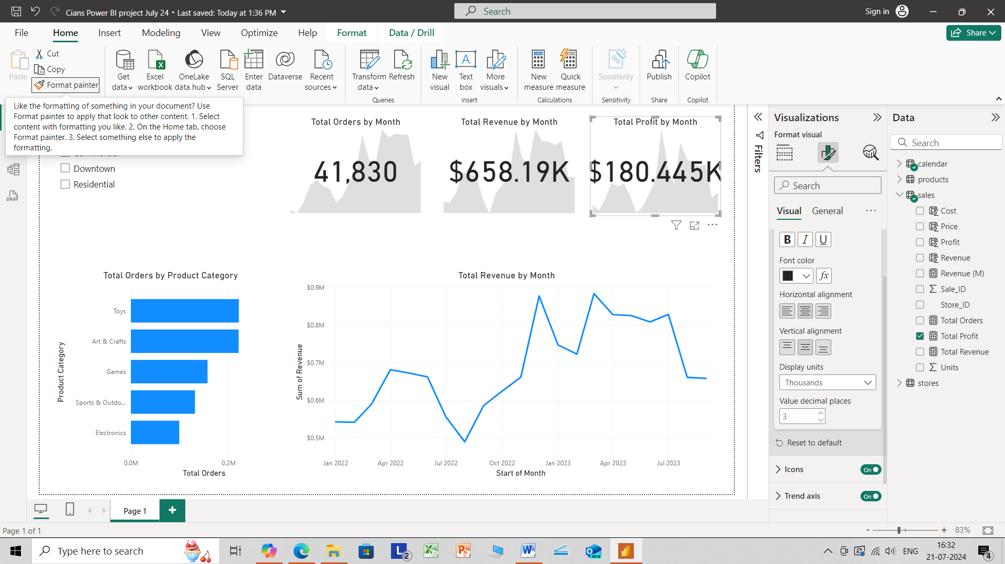

Slide 26
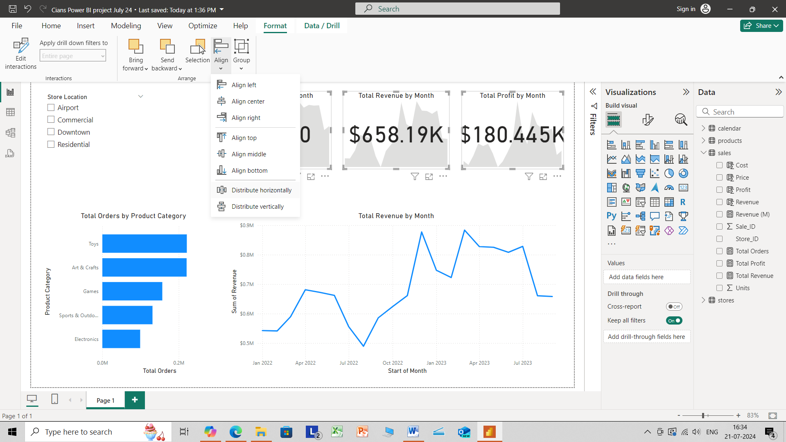

Slide 27
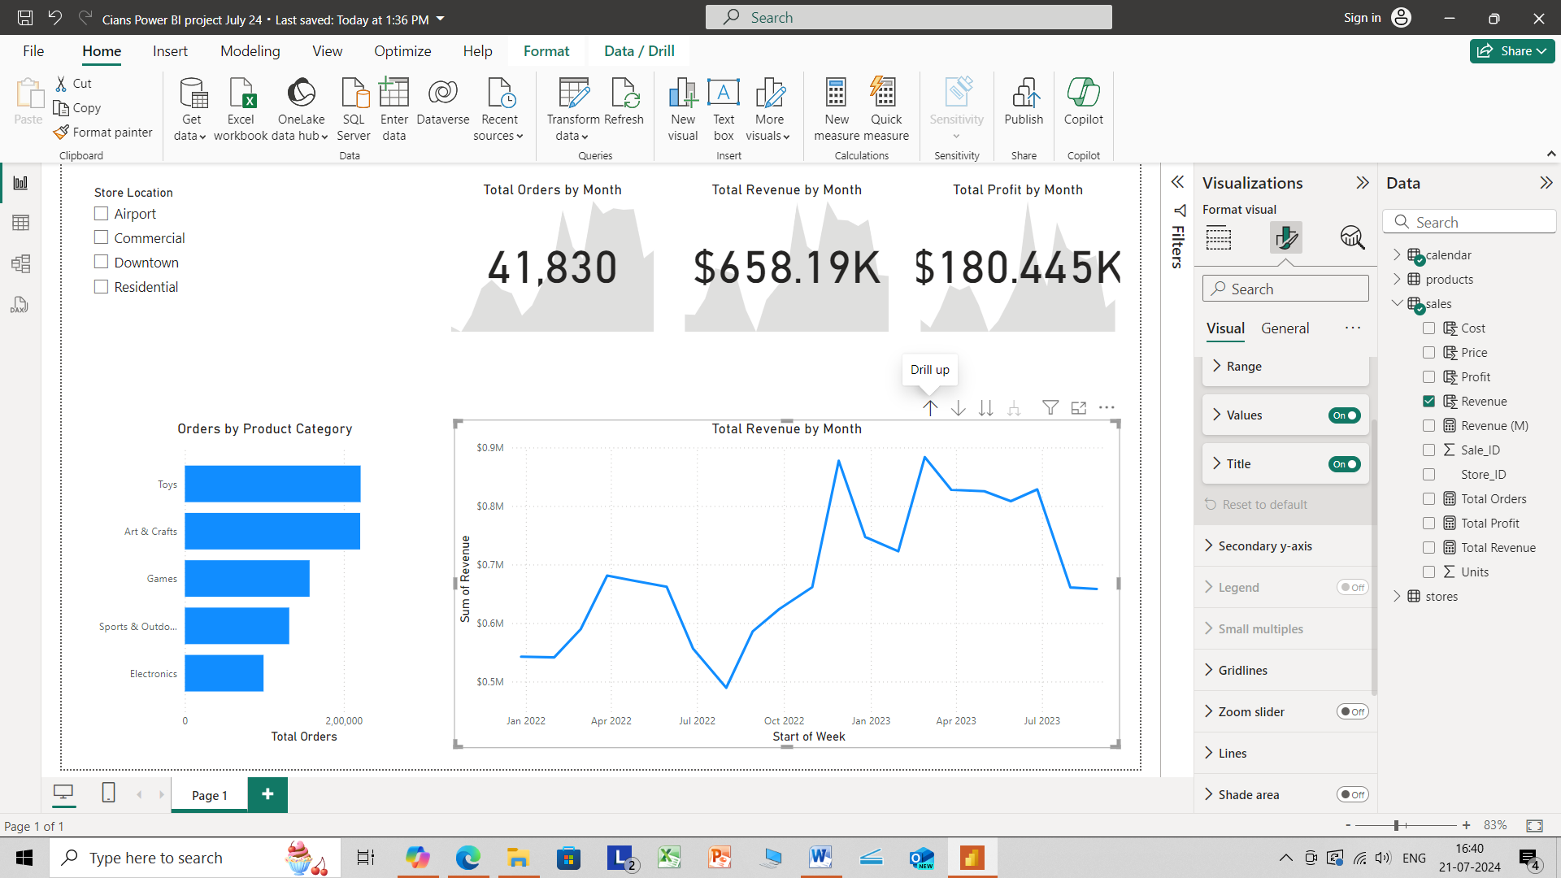

Slide 28
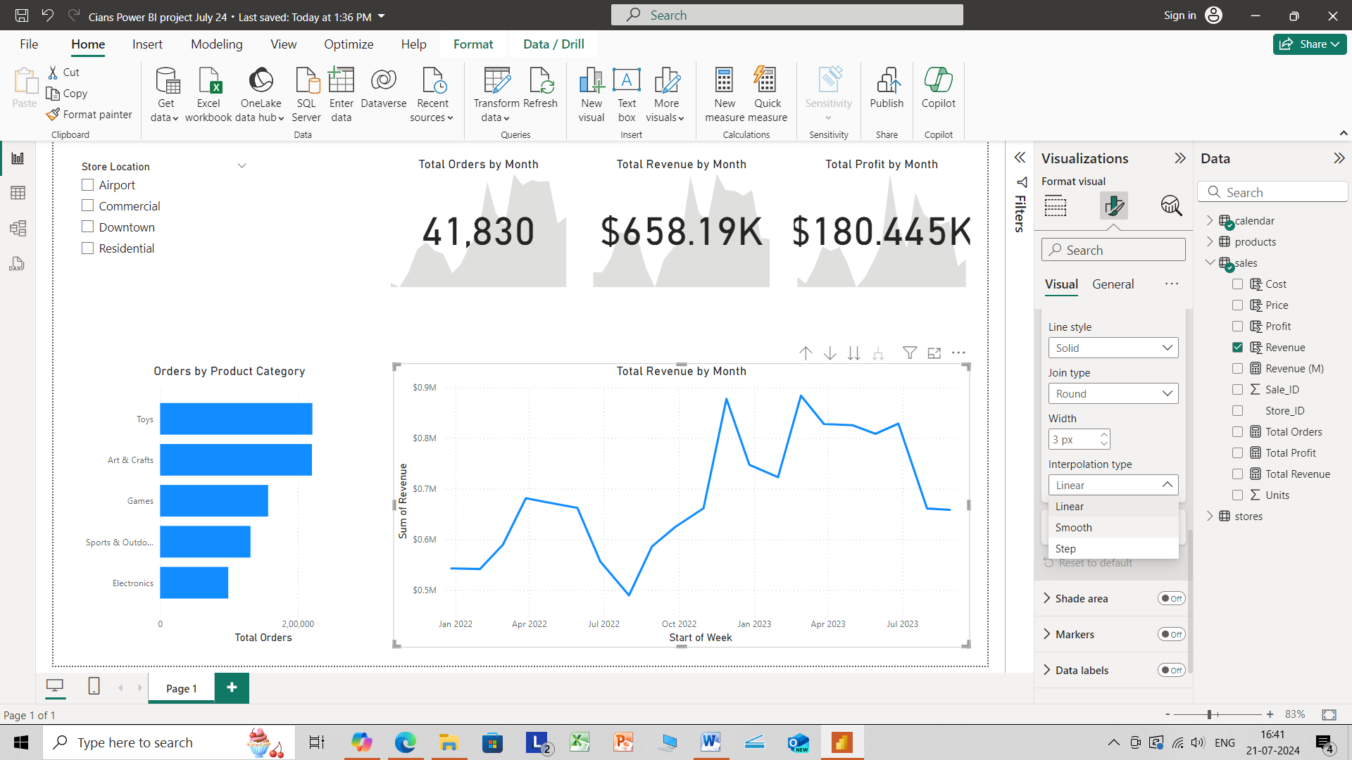

Slide 29
